Slide 1
Department of CSE, CSIT,
COURSE NAME: Data science
COURSE CODE: 24AD3107
Topic:
Data Quality Issues, Missing Data, Noise
Session - 5

Slide 2



AIM OF THE SESSION
To familiarize students with the basic concept of Data science
INSTRUCTIONAL OBJECTIVES
This Session is designed to: Data Quality Issues, Missing Data, Noise
LEARNING OUTCOMES
At the end of this session, you should be able to: Data Quality Issues, Missing Data, Noise

Slide 3
Key Concepts
SESSION INTRODUCTION
Definition of Quality
Definition of Process Quality
Missing Data
Noise

Slide 4
Data Quality Issues
DATA QUALITY ISSUES
Data quality is the bedrock of any reliable machine learning or analytics system.
Poor-quality data leads to inaccurate models, misleading insights, and bad decisions — a concept often summarized as "garbage in, garbage out.
Data quality issues are problems or errors in data that reduce its usefulness, reliability, and accuracy for analysis and decision-making.
Poor-quality data leads to:
Wrong predictions
Inaccurate analysis
Poor business decisions
Reduced Machine Learning performance

Slide 5
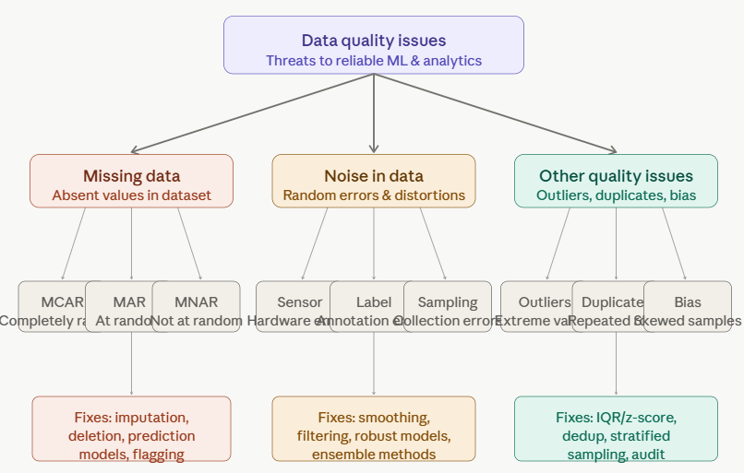
Therefore, identifying and resolving data quality issues is one of the most important tasks in Data Science

Slide 6
MAJOR DATA QUALITY ISSUES
Missing Data
Noisy Data
Outliers
Inconsistent Data/Incorrect Data
Duplicate Data
Class Imbalance
Data Drift
Selection/Sampling Bias

Slide 7
MISSING DATA
Missing Data
Missing data occurs when one or more values are absent for an observation. It's one of the most common real-world data problems and, if unhandled, silently distorts model training and evaluation.
Types of Missingness
MCAR — Missing Completely at Random Values are missing with no relationship to any other variable. Example: a survey respondent skips a question by accident. This is the most benign form — the observed data is still an unbiased sample of the full dataset. Deletion is safe here.
MAR — Missing at Random Missingness depends on other observed variables, but not on the missing value itself. Example: younger respondents skip income questions more often, but age is recorded. Once you account for age, the missingness is random. This is treatable with careful imputation.

Slide 8
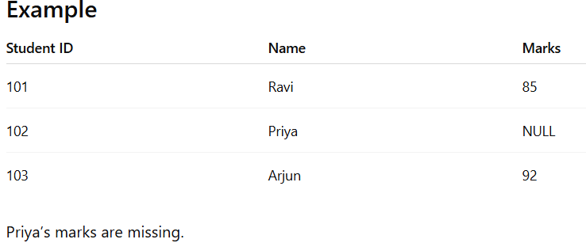
MISSING DATA
MNAR — Missing Not at Random The missingness depends on the unobserved value itself. Example: people with very high or very low incomes avoid disclosing it. This is the most dangerous type — it introduces systematic bias that is very hard to correct without domain knowledge.
Impact on Models
Algorithms like linear regression and neural networks cannot process NaN values natively.
Ignored missing data causes biased parameter estimates.
If missingness is MNAR, even sophisticated imputation can mislead the model.

Slide 9
MISSING DATA
Data is not always available
  E.g., many tuples have no recorded value for several attributes, such as customer income in sales data
Missing data may be due to
  Equipment malfunction
  Inconsistent with other recorded data and thus deleted
  Data not entered due to misunderstanding
  Certain data may not be considered important at the time of entry
  Not register history or changes of the data
Missing data may need to be inferred.

Slide 10
Handling Missing Data
Ignore the tuple: usually done when class label is missing (assuming the tasks in classification—not effective when the percentage of missing values per attribute varies considerably.
Fill in the missing value manually: tedious + infeasible?
Use a global constant to fill in the missing value: e.g., “unknown”, a new class?!
Imputation: Use the attribute mean to fill in the missing value, or use the attribute mean for all samples belonging to the same class to fill in the missing value: smarter
Use the most probable value to fill in the missing value: inference-based such as Bayesian formula or decision tree

Slide 11
Unified Date Format
We want to transform all dates to the same format internally
Some systems accept dates in many formats
  e.g. “Sep 24, 2003”, 9/24/03, 24.09.03, etc
  dates are transformed internally to a standard value
Frequently, just the year (YYYY) is sufficient
For more details, we may need the month, the day, the hour, etc
Representing date as YYYYMM or YYYYMMDD can be OK, but has problems

Slide 12
Unified Date Format Options
To preserve intervals, we can use
  Unix system date: Number of seconds since 1970
  Number of days since Jan 1, 1960 (SAS)
Problem:
  values are non-obvious
  don’t help intuition and knowledge discovery
  harder to verify, easier to make an error

Slide 13
Conversion: Nominal to Numeric
Some tools can deal with nominal values internally
Other methods (neural nets, regression, nearest neighbor) require only numeric inputs
To use nominal fields in such methods need to convert them to a numeric value
  Q: Why not ignore nominal fields altogether?
  A: They may contain valuable information
Different strategies for binary, ordered, multi-valued nominal fields

Slide 14
Conversion: Binary to Numeric
Binary fields
  E.g. Gender = M, F
Convert to Field_0_1 with 0, 1 values
  e.g. Gender = M → Gender_0_1 = 0
  Gender = F → Gender_0_1 = 1

Slide 15
NOISE
Noise in Data
Noise refers to random errors or variance in the measured variables that obscure the true underlying signal. Unlike missing data, noisy values are present — they just don't accurately represent reality.
Sources of Noise:
Sensor/instrument noise — hardware limitations, calibration drift, electrical interference. Common in IoT, medical devices, and industrial monitoring.
Label noise — incorrect annotations by human labelers, especially in large-scale crowd sourced datasets. A misclassified image (a dog labeled "cat") directly poisons supervised learning.
Sampling noise — randomness inherent in taking a finite sample from a larger population. Unavoidable, but reducible with larger sample sizes.
Transcription/entry errors — typos, unit mismatches, copy-paste errors in manually entered data.

Slide 16
Measurement noise — the act of measurement itself introduces error (e.g., rounding a continuous reading, discretizing a signal).
Impact on Models
Overfitting: a model trained on noisy data may memorize the noise rather than the true pattern.
Underfitting: excessive noise can mask real patterns entirely.
Degraded decision boundaries in classifiers.
Inflated error metrics that misrepresent model performance.

Slide 17
Handling Noisy Data
Binning method:
  first sort data and partition into (equi-depth) bins
  then one can smooth by bin means, smooth by bin median, smooth by bin boundaries, etc.
Clustering
  detect and remove outliers
Combined computer and human inspection
  detect suspicious values and check by human
Regression
  smooth by fitting the data into regression functions

Slide 18
Simple Discretization Methods: Binning
Equal-width(distance) partitioning:
It divides the range into N intervals of equal size: uniform grid
if A and B are the lowest and highest values of the attribute, the width of intervals will be: W = (B-A)/N.
The most straightforward
But outliers may dominate presentation
Skewed data is not handled well.
Equal-depth(frequency) partitioning:
It divides the range into N intervals, each containing approximately same number of samples
Good data scaling
Managing categorical attributes can be tricky.

Slide 19
Binning Methods for Data Smoothing
Sorted data for price (in dollars): 4, 8, 9, 15, 21, 21, 24, 25, 26, 28, 29, 34
Partition into (equi-depth) bins:
  -Bin 1: 4, 8, 9, 15
  -Bin 2: 21, 21, 24, 25
  -Bin 3: 26, 28, 29, 34
Smoothing by bin means:
  -Bin 1: 9, 9, 9, 9
  -Bin 2: 23, 23, 23, 23
  -Bin 3: 29, 29, 29, 29
Smoothing by bin boundaries:
  -Bin 1: 4, 4, 4, 15
  -Bin 2: 21, 21, 25, 25
  -Bin 3: 26, 26, 26, 34

Slide 20
Handling Strategies:
Smoothing: moving averages, Gaussian smoothing, Savitzky-Golay filters for time series.
Dimensionality reduction: PCA can separate signal dimensions from noise dimensions.
Robust loss functions: Huber loss instead of MSE reduces sensitivity to label noise.
Data augmentation: strategically adding noise during training to build robustness.
Ensemble methods: averaging across many models reduces noise sensitivity.
Noise-tolerant algorithms: decision trees with pruning, robust SVMs.
Re-labeling campaigns: for label noise, use multiple annotators and majority voting.

Slide 21
Data smoothing - Regression
Linear regression involves finding the “best” line to fit two attributes (or variables), so that one attribute can be used to predict the other.
Multiple linear regression is an extension of linear regression, where more than two attributes are involved and the data are fit to a multidimensional surface.

Slide 22
Data smoothing - Outlier analysis
Outliers may be detected by clustering, for example, where similar values are organized into groups, or “clusters.”
Intuitively, values that fall outside of the set of clusters may be considered outliers

Slide 23
Other Major Data Quality Issues
Outliers
Outliers are abnormal values significantly different from normal data.
Values that are statistically far from the rest of the distribution. Outliers can be genuine (a real but rare event) or erroneous (a sensor spike). They inflate variance and distort means, regression coefficients, and distance-based algorithms.
Detection methods: Z-score (beyond ±3σ), IQR method (below Q1 − 1.5×IQR or above Q3 + 1.5×IQR), isolation forests, DBSCAN-based detection.
Example: Student marks: 45, 50, 48, 1000 where 1000 is an outlier.
Inconsistent / Incorrect Data
Values that violate domain constraints (e.g., a person's age recorded as −5 or 900), mixed formats (dates as "Jan 3" vs "2024-01-03"), or conflicting records across sources. Requires domain-aware validation rules and schema enforcement.

Slide 24
Duplicate Records
The same entity appears multiple times, often from merging datasets. Duplicates artificially inflate class frequencies and leak information from training into test sets. Fixed with deduplication via exact matching, fuzzy matching, or entity resolution. Ex: Banking System - A customer may accidentally create multiple accounts with the same details.
Class Imbalance
One class vastly outnumbers another (e.g., 99% non-fraud vs 1% fraud). A model that predicts the majority class always achieves high accuracy but zero utility. Fixed with oversampling (SMOTE), undersampling, class-weighted loss, or threshold tuning.
Data Drift
The statistical distribution of input features changes over time after deployment, silently degrading model performance. Monitored with PSI (Population Stability Index), KS tests, and model performance dashboards.

Slide 25
Selection / Sampling Bias
The data collection process systematically favors certain subpopulations, so the training set doesn't represent the real-world distribution. A classic example is training a facial recognition system on predominantly light-skinned faces — it performs poorly on darker skin tones.

Slide 26

THANK YOU
Team – DS

